Slide 1
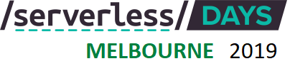
Azure Serverless Security
Pratik Khasnabis
Azure Cloud Architect (MCSE & MCSD)
@softveda

Slide 2
Serverless Architecture
“Serverless architectures are application designs that incorporate third-party “Backend as a Service” (BaaS) services, and/or that include custom code run in managed, ephemeral containers on a “Functions as a Service” (FaaS) platform. By using these ideas, and related ones like single-page applications, such architectures remove much of the need for a traditional always-on server component. …”
- Martin Fowler
SPA App
FaaS
BaaS
Notes:
https://martinfowler.com/articles/serverless.html

Slide 3
Serverless Security
Just because there is no servers to manage doesn’t absolve you from the responsibility of securing your serverless architecture.
Security on cloud is everyone's responsibility including the development team, the SRE/Ops team, Cyber Security team and of course your cloud vendor.
Security controls also depend on the threat model and risks identified for your specific application. There is no one size fits all solution to cyber security.

Slide 4
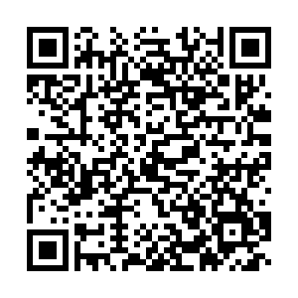
Securing your Azure Account
Your Pa$$word doesn't matter
Enabling multi-factor authentication (MFA) for accounts will end up blocking 99.9% of automated attacks.

Slide 5
AppSEC Practices
“UK cybersecurity agency warns devs to drop Python 2 due to looming EOL & security risks”
“Backdoors snuck into 12 OSS packages were downloaded hundreds of thousands of times.”
Secure coding practices
Protect against OWASP Top 10
Do Input validation
Logging and Monitoring
Enable HTTPS only with TLS 1.2
Framework currency
Dependencies vulnerability scans
“Equifax breach was ‘entirely preventable’ had it used basic security measures, says House report.
The credit agency failed to patch a disclosed vulnerability in Apache Struts, a common open source web server.”
Notes:
https://snyk.io/

Slide 6
Typical Serverless Architecture on Azure

Slide 7
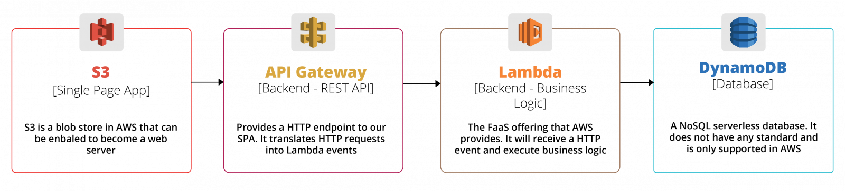
Typical Serverless Architecture on AWS

Slide 8
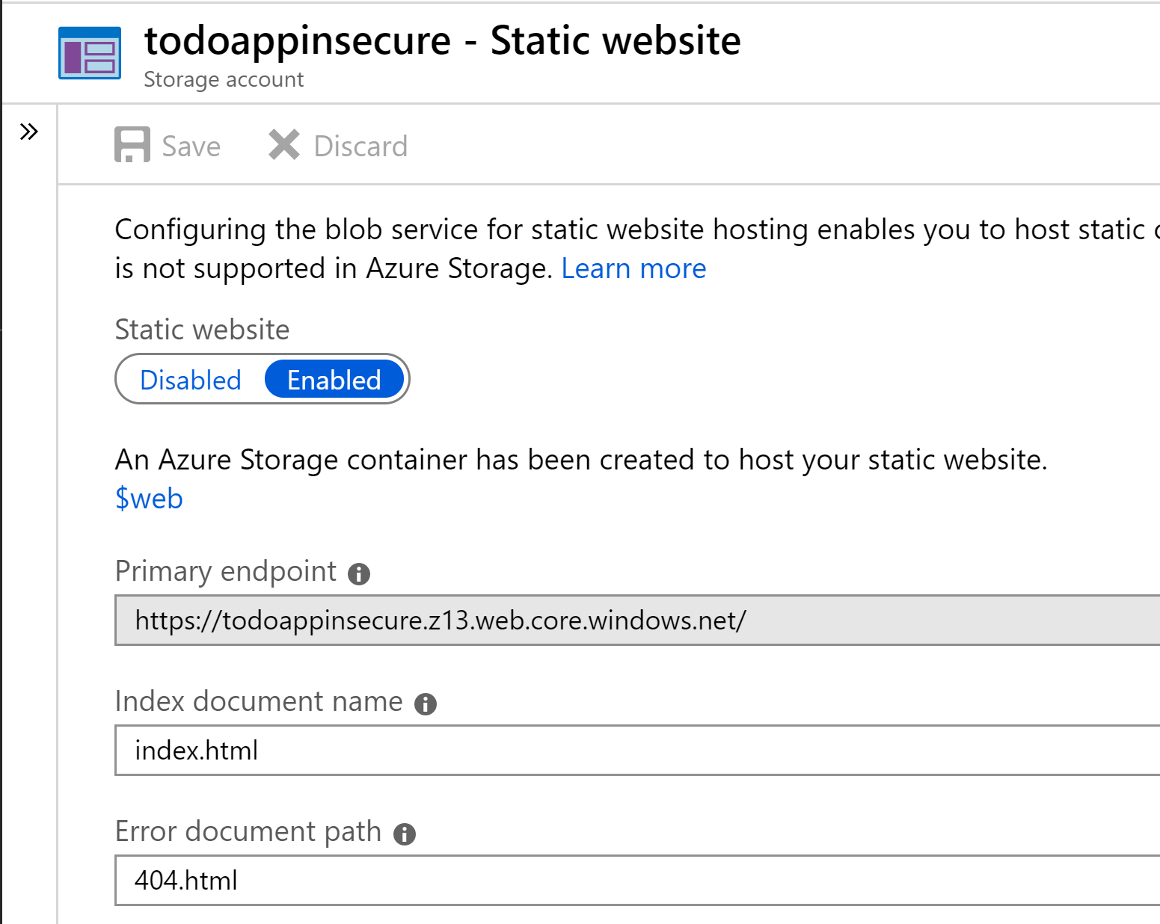
Azure Blobs – Static Website Hosting
https://todoappinsecure.z13.web.core.windows.net/

Slide 9
Todo App - SPA Code
const azureFuncUrl = "https://todoinsecurefunctionapp.azurewebsites.net/api/todo/";
function callSearchAPi() {
var id = $("#searchInput").val();
$.ajax({
url: azureFuncUrl + id,
type: "GET
…
}
$("#searchBtn").click(function () {
clearErrorMessage();
callSearchAPi();
})

Slide 10
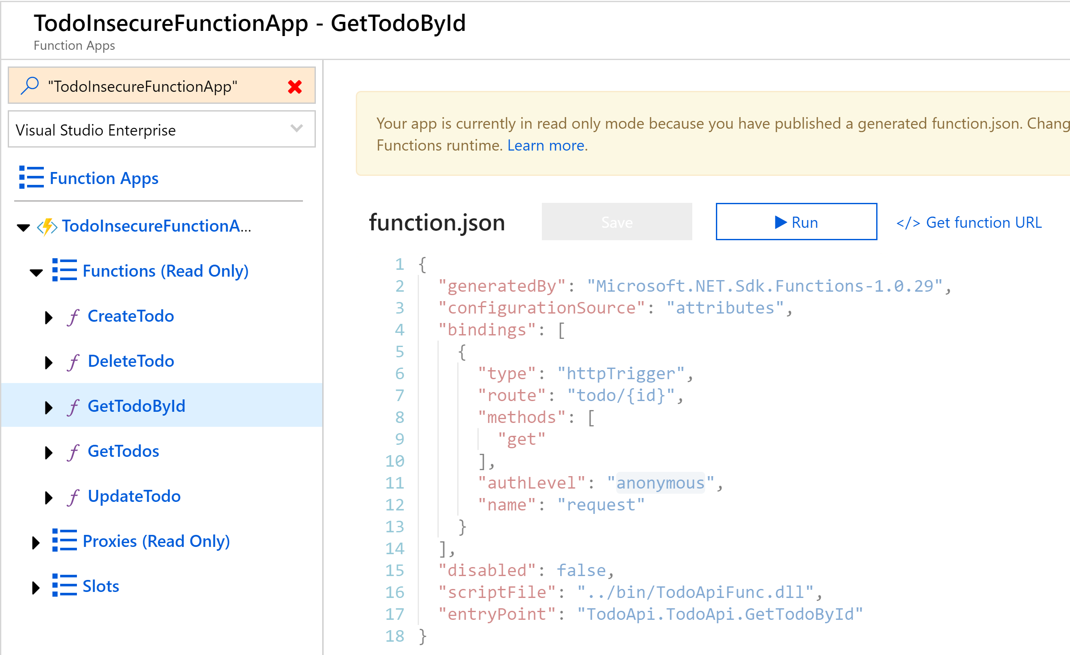
Todo Function
https://todoinsecurefunctionapp.azurewebsites.net/api/todo/{id}

Slide 11
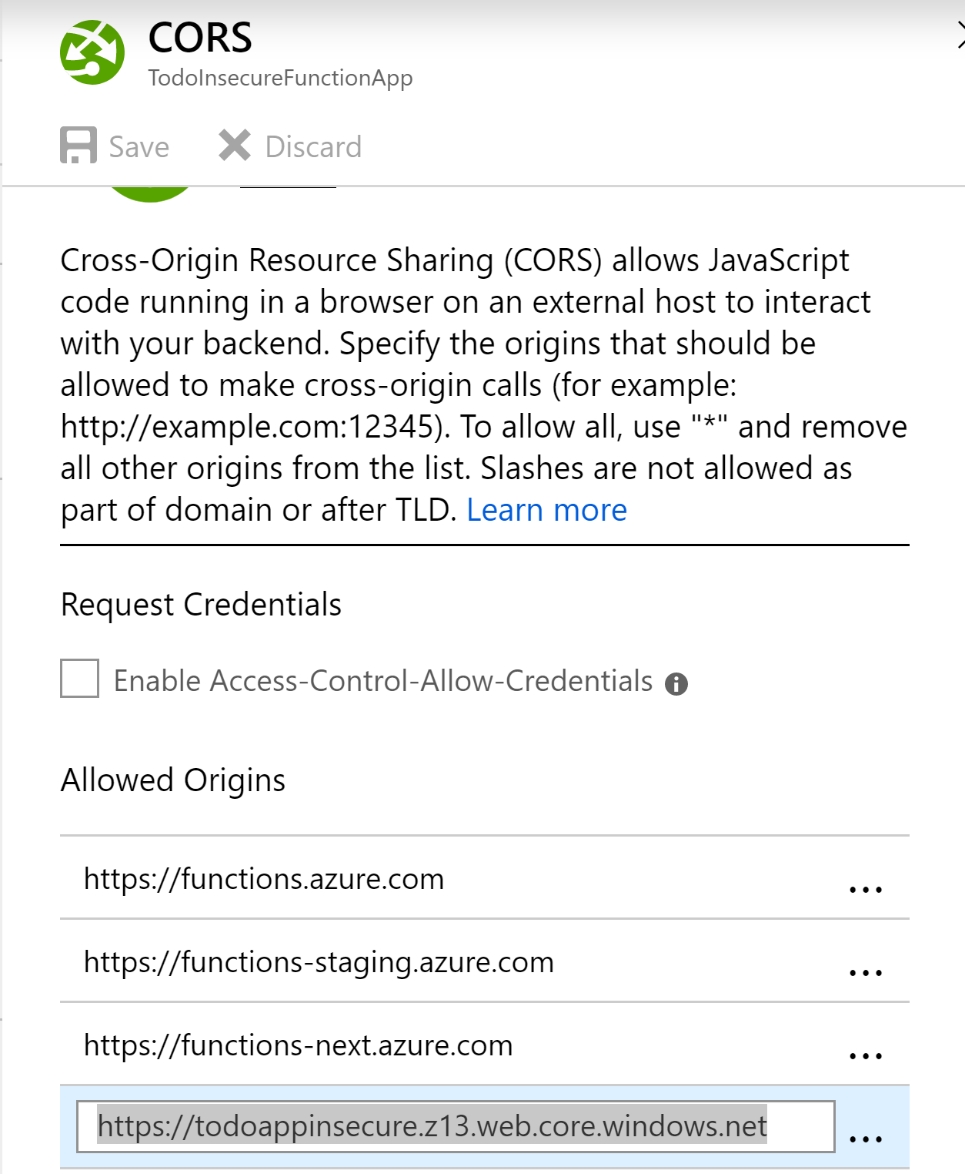
Setting CORS

Slide 12
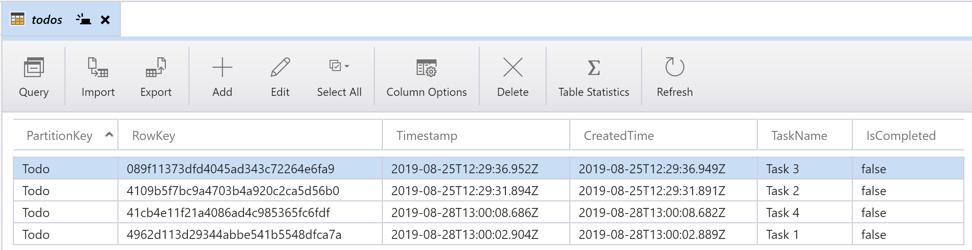
Todo Table Storage
Connection String in Function App Application Settings

Slide 13
Is this App Secure?

Slide 14
Problem Statement
How do we make sure that the REST API calls from the SPA to Azure Function is secure as in only authenticated and authorised users can invoke the Azure Function.
How do we make sure that only the Azure Function app can access the backend Database and secure the credential.

Slide 15
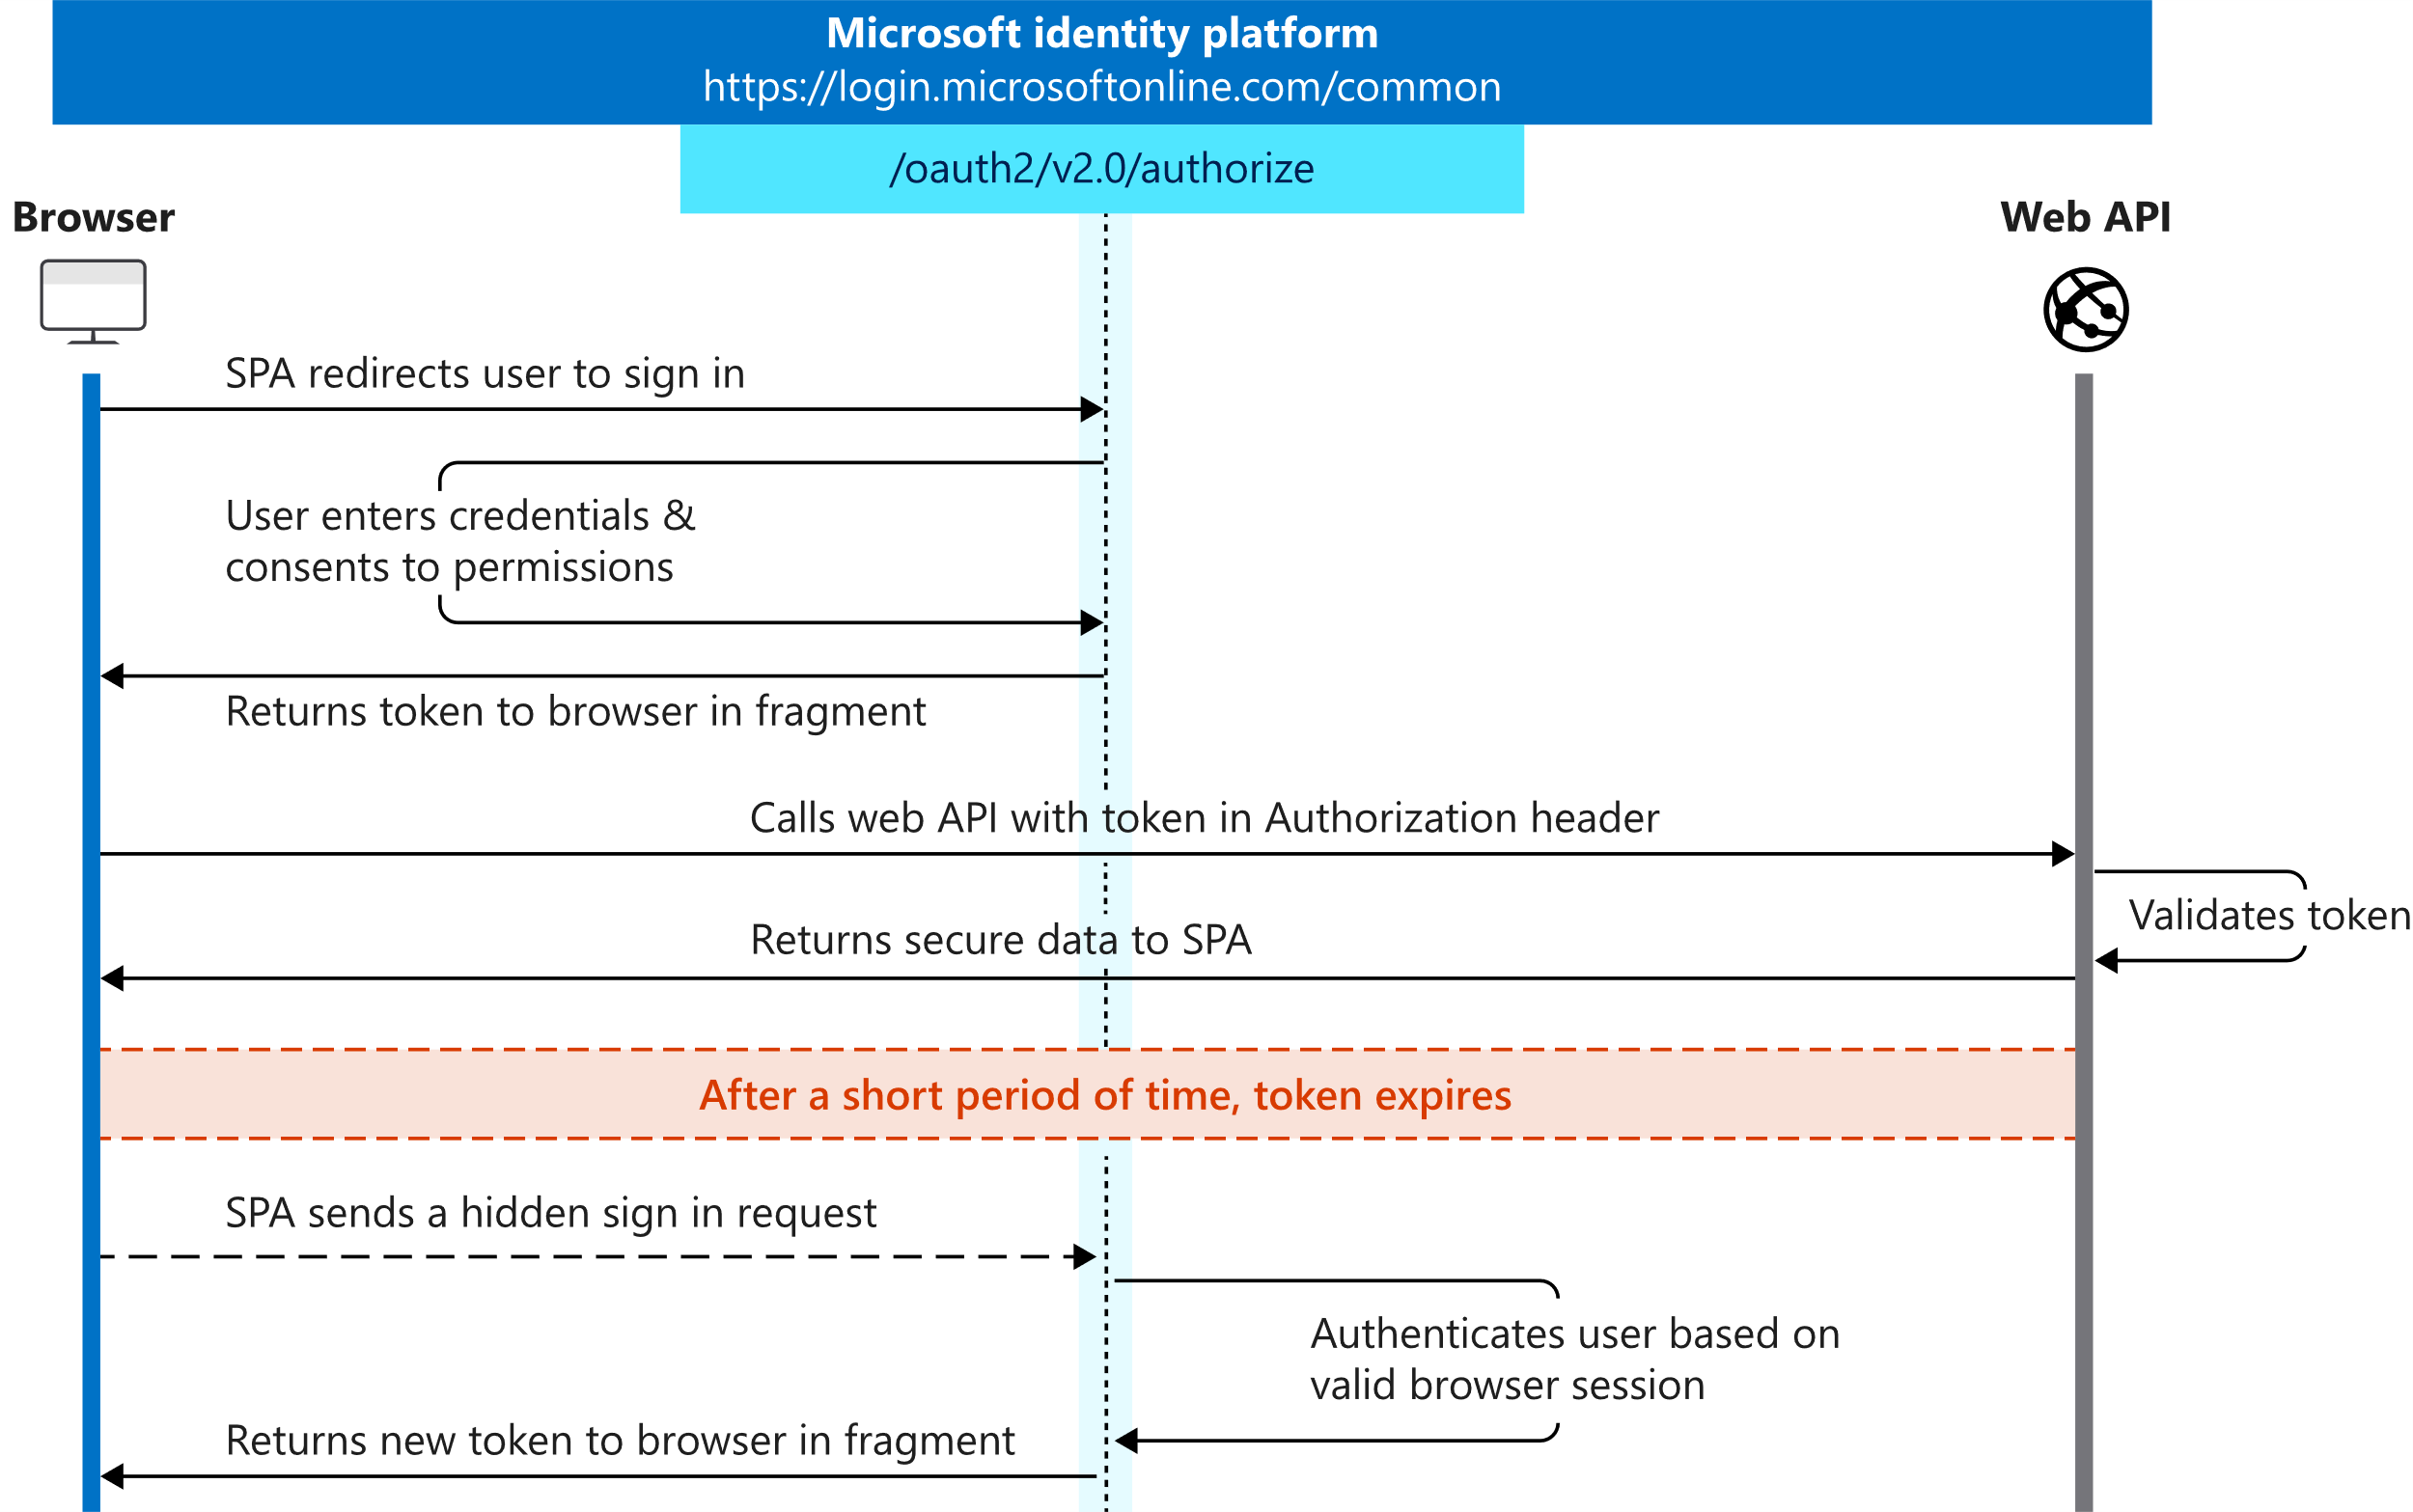
OAUTH 2.0 Implicit Grant Flow
Notes:
https://docs.microsoft.com/en-us/azure/active-directory/develop/v2-oauth2-implicit-grant-flow

Slide 16
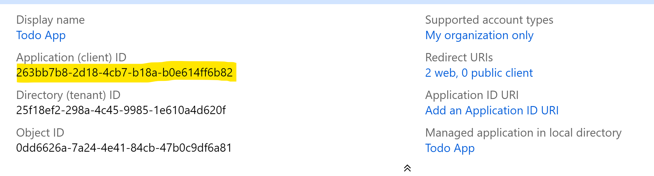
Register Todo App in Azure AD

Slide 17
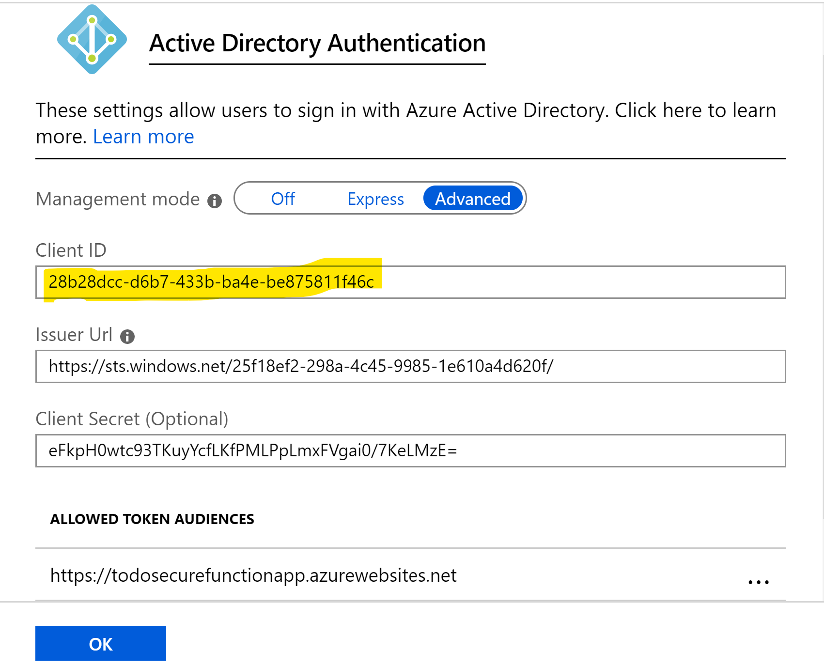
Register Todo API Function in Azure AD

Slide 18
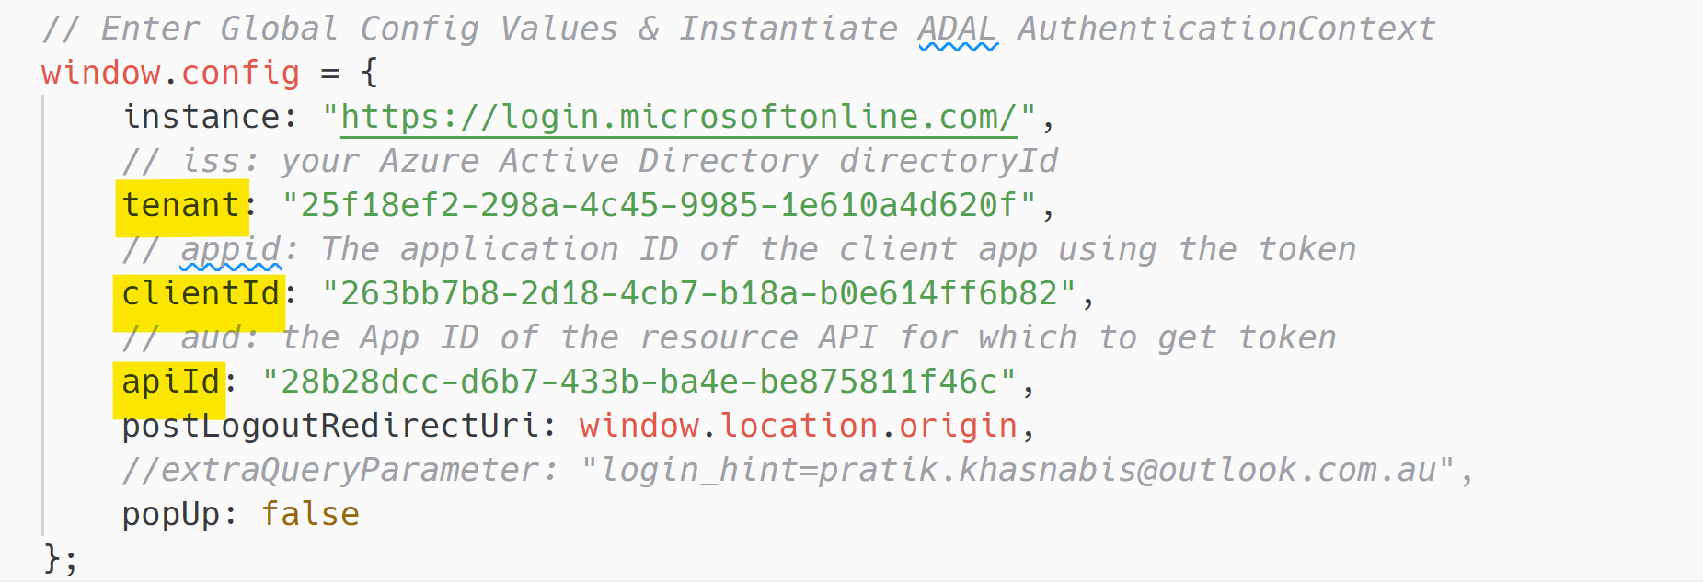
Todo App Secure –SPA Code

Slide 19
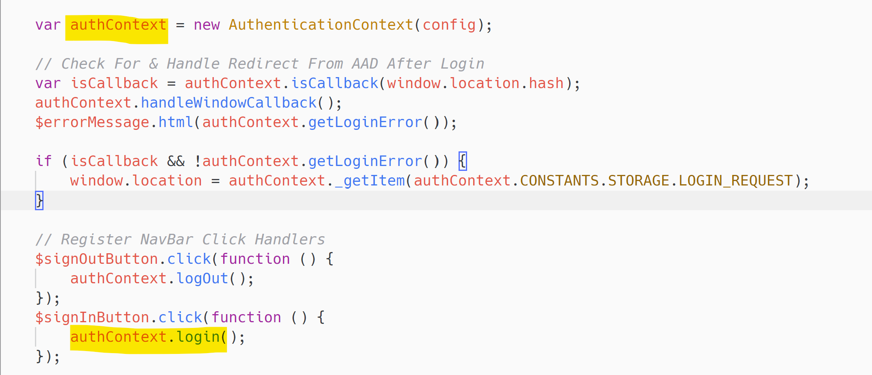
ADAL.JS – Login

Slide 20
Grant Permission on First Login

Slide 21
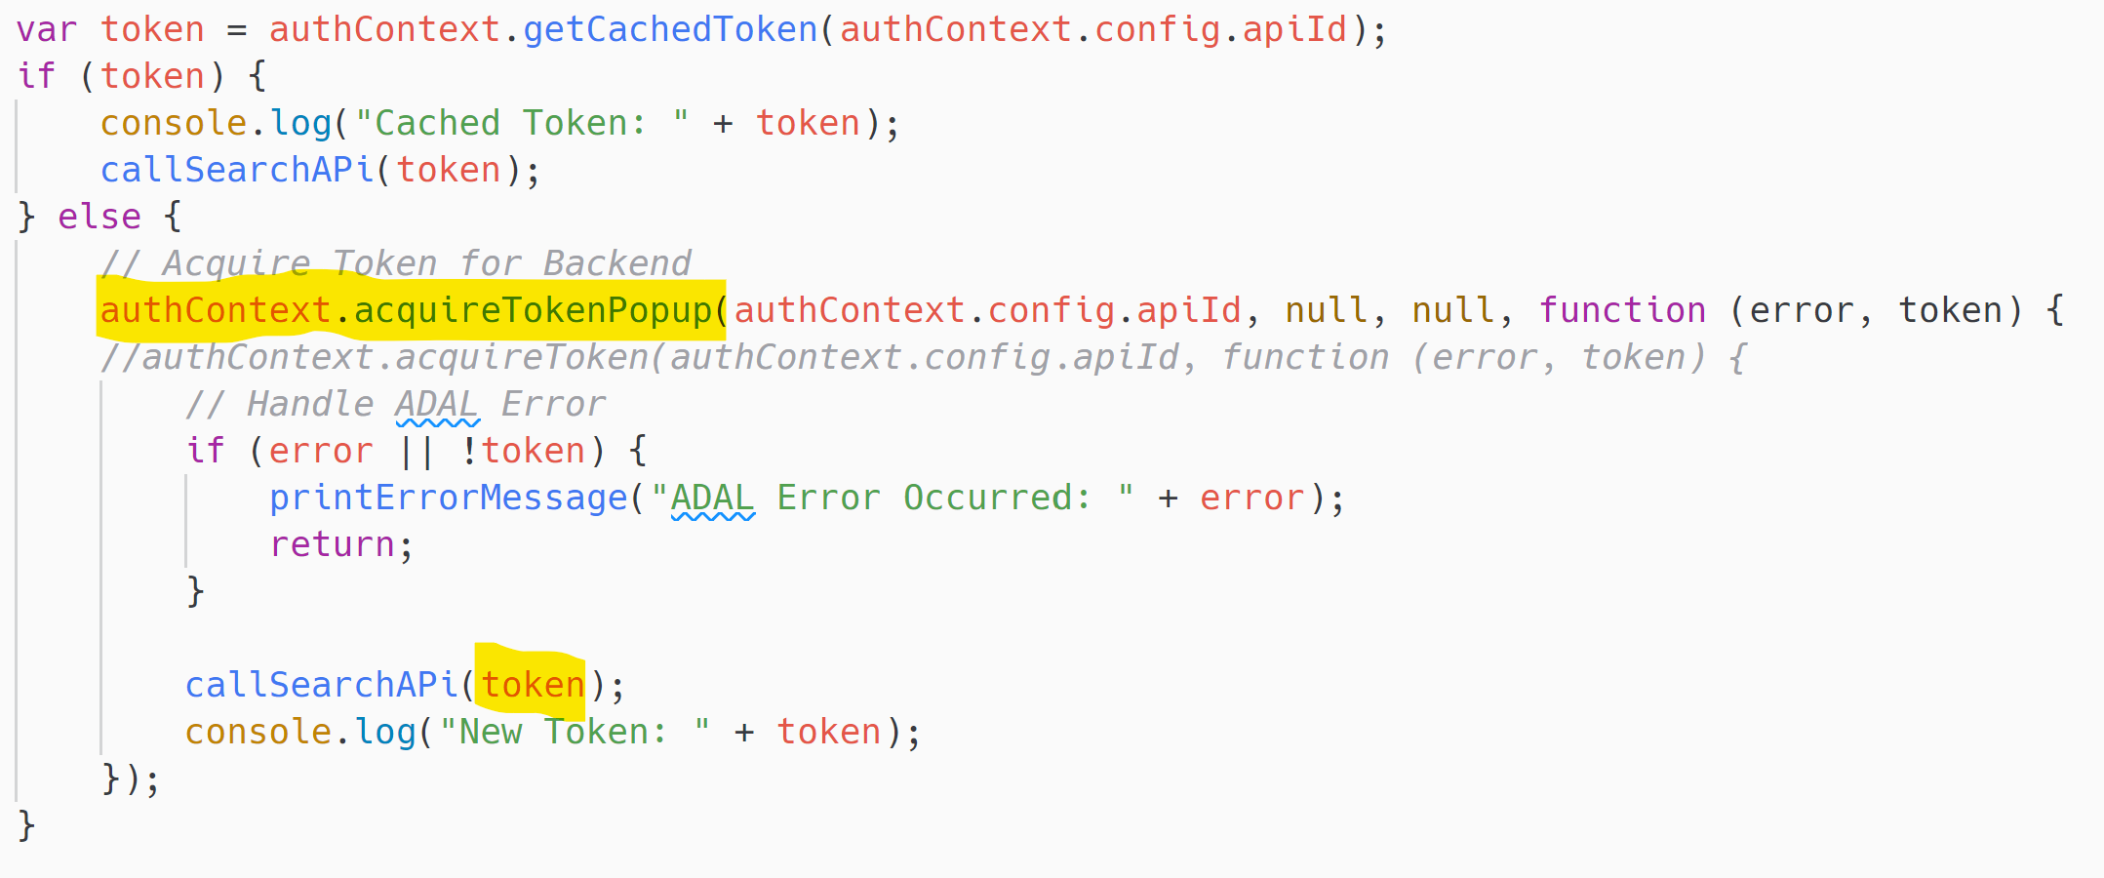
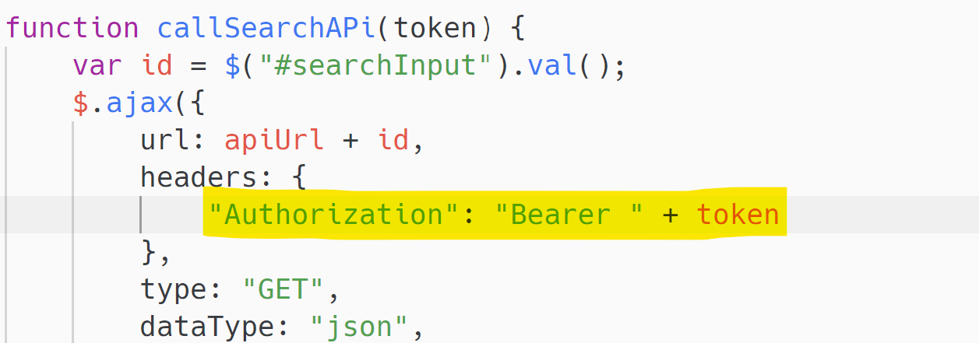
ADAL.JS – Get Acess Token

Slide 22
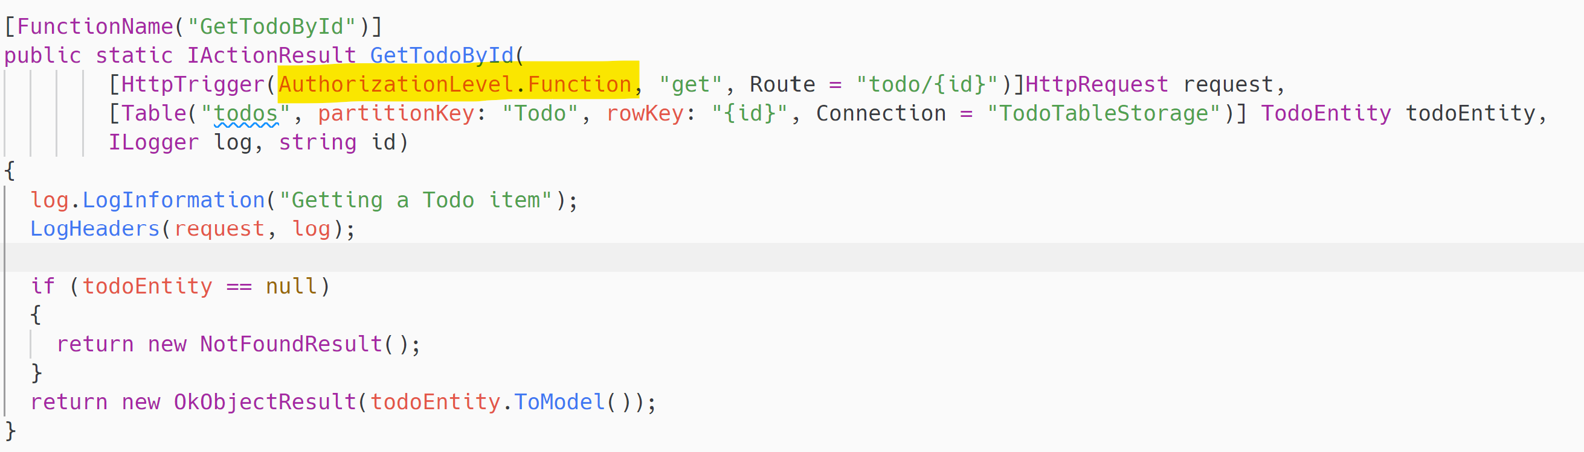
Change Authentication to Function
Notes:
https://login.microsoftonline.com/{tenant}/.well-known/openid-configuration

Slide 23
Azure API Management
Reducing the attack surface
CORS Policy
Validate JWT Policy
Rate limiting

Slide 24
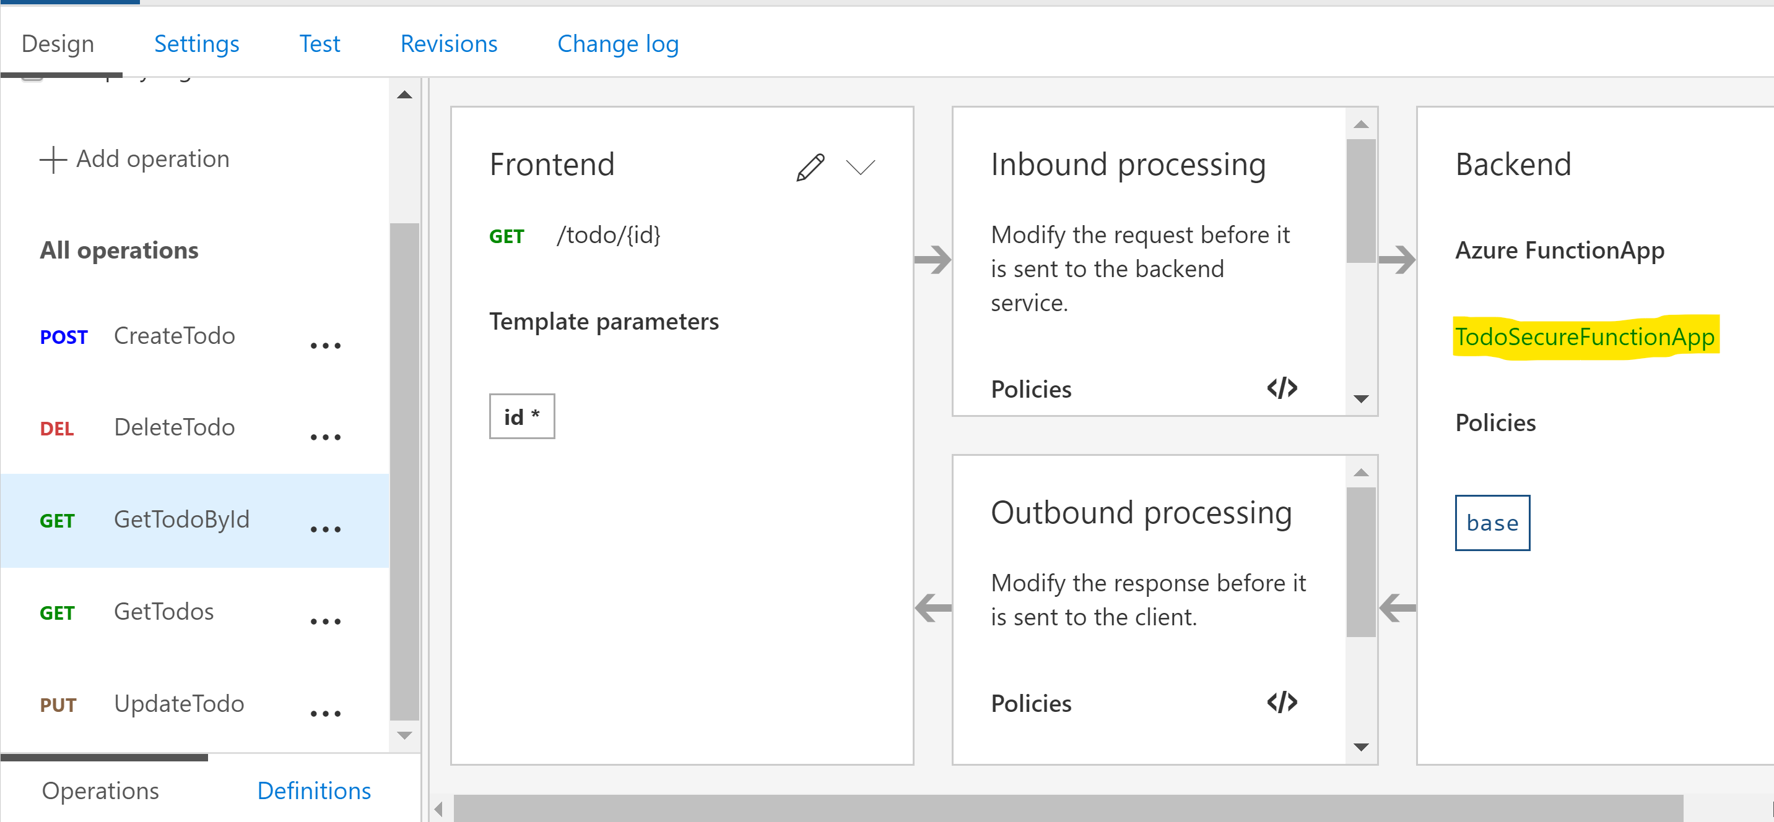
Publish Todo Function App in Azure APIM

Slide 25
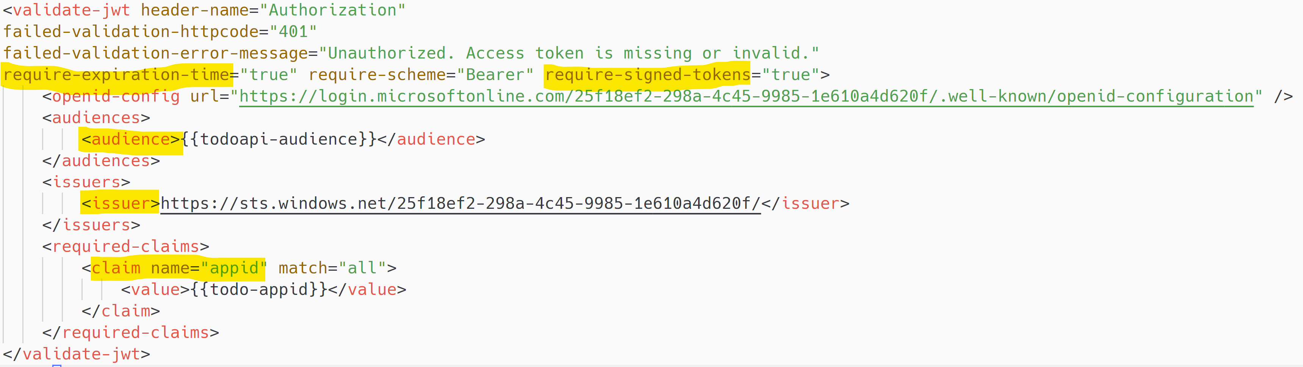
Configure Validate-JWT Policy

Slide 26
Is this App Secure?

Slide 27
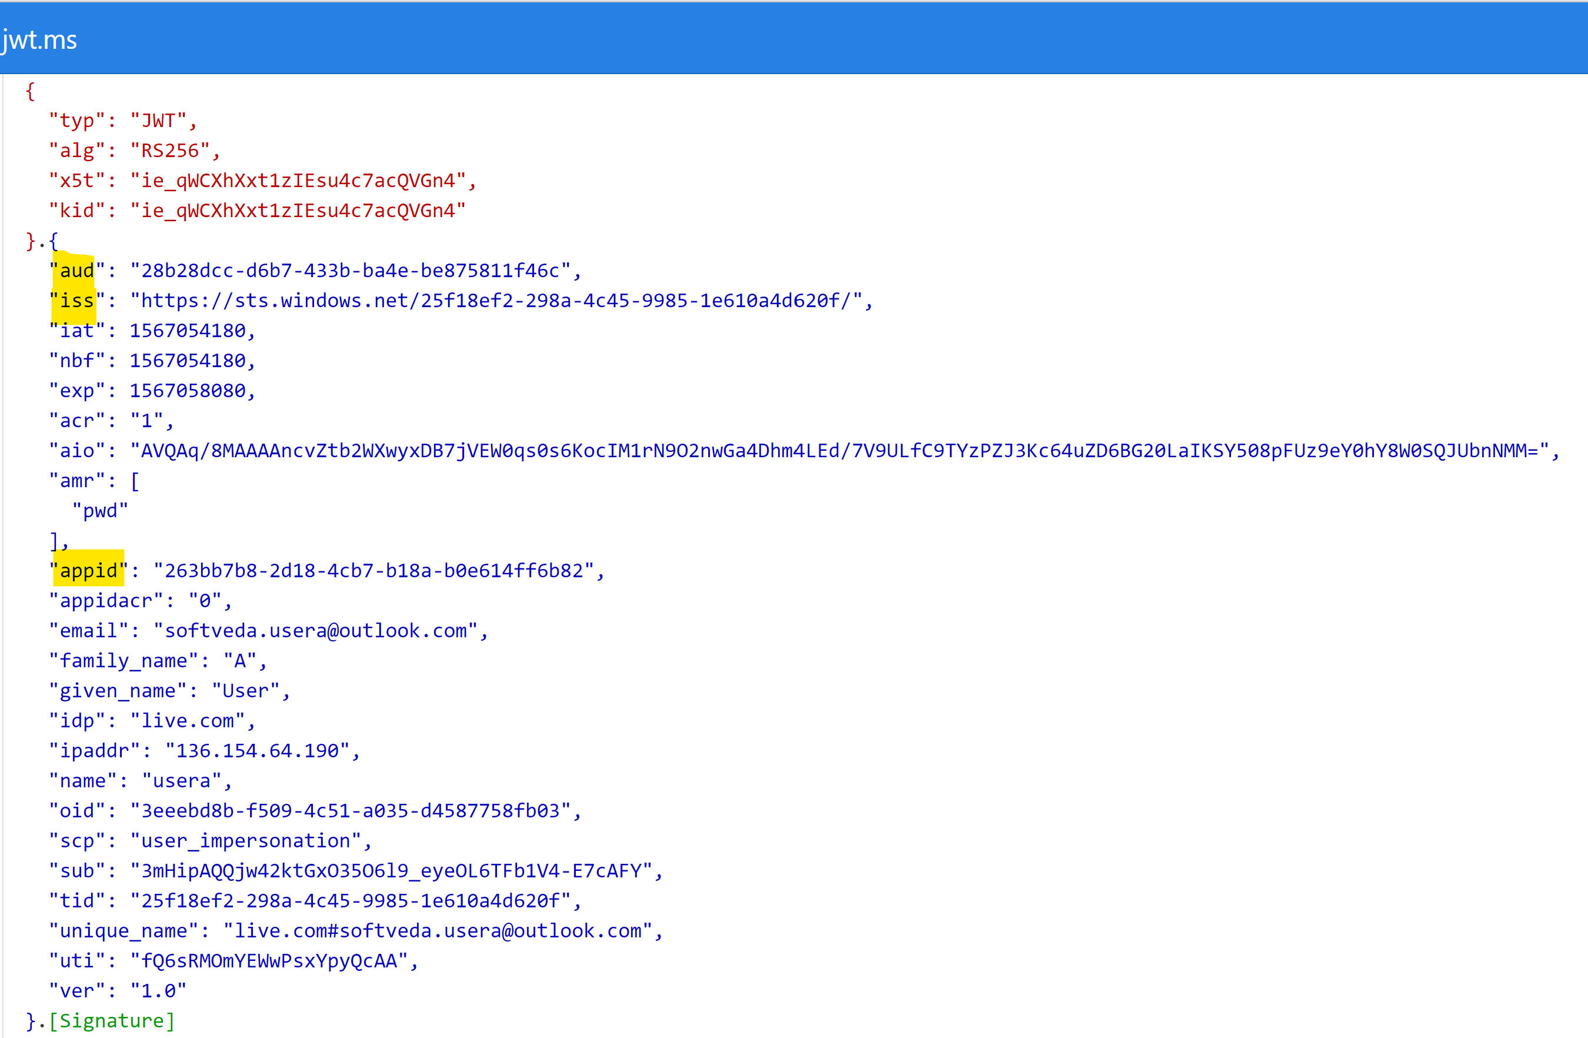
Inspect The JWT Access Token

Slide 28
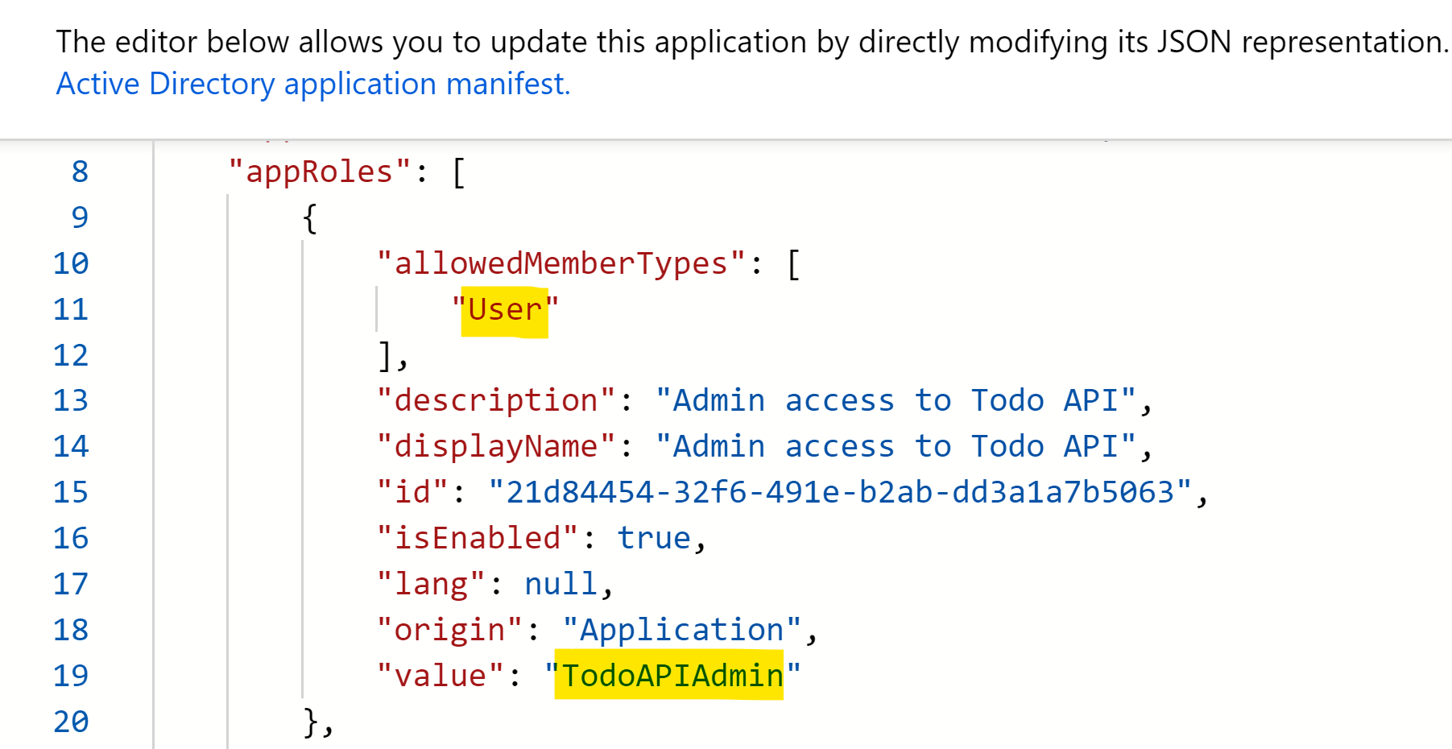
Add Application role in Manifest

Slide 29
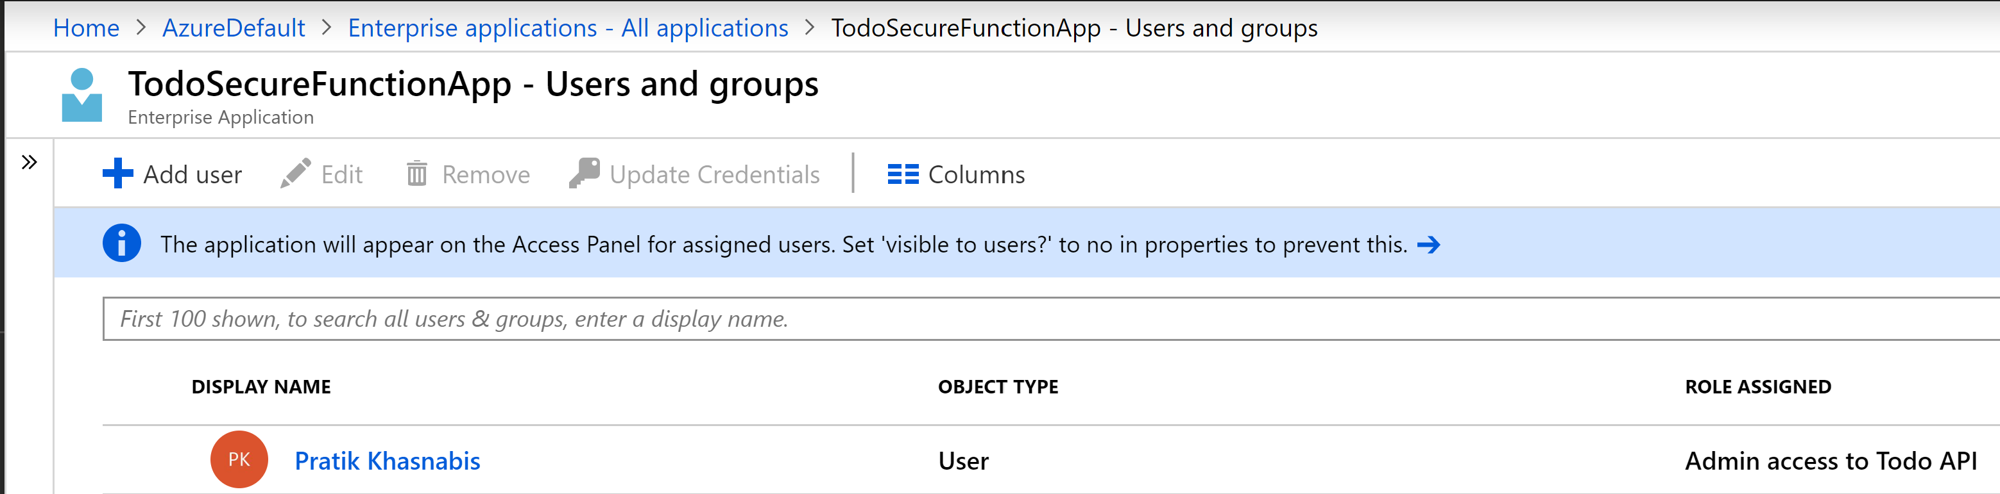
Grant Application Role to User

Slide 30
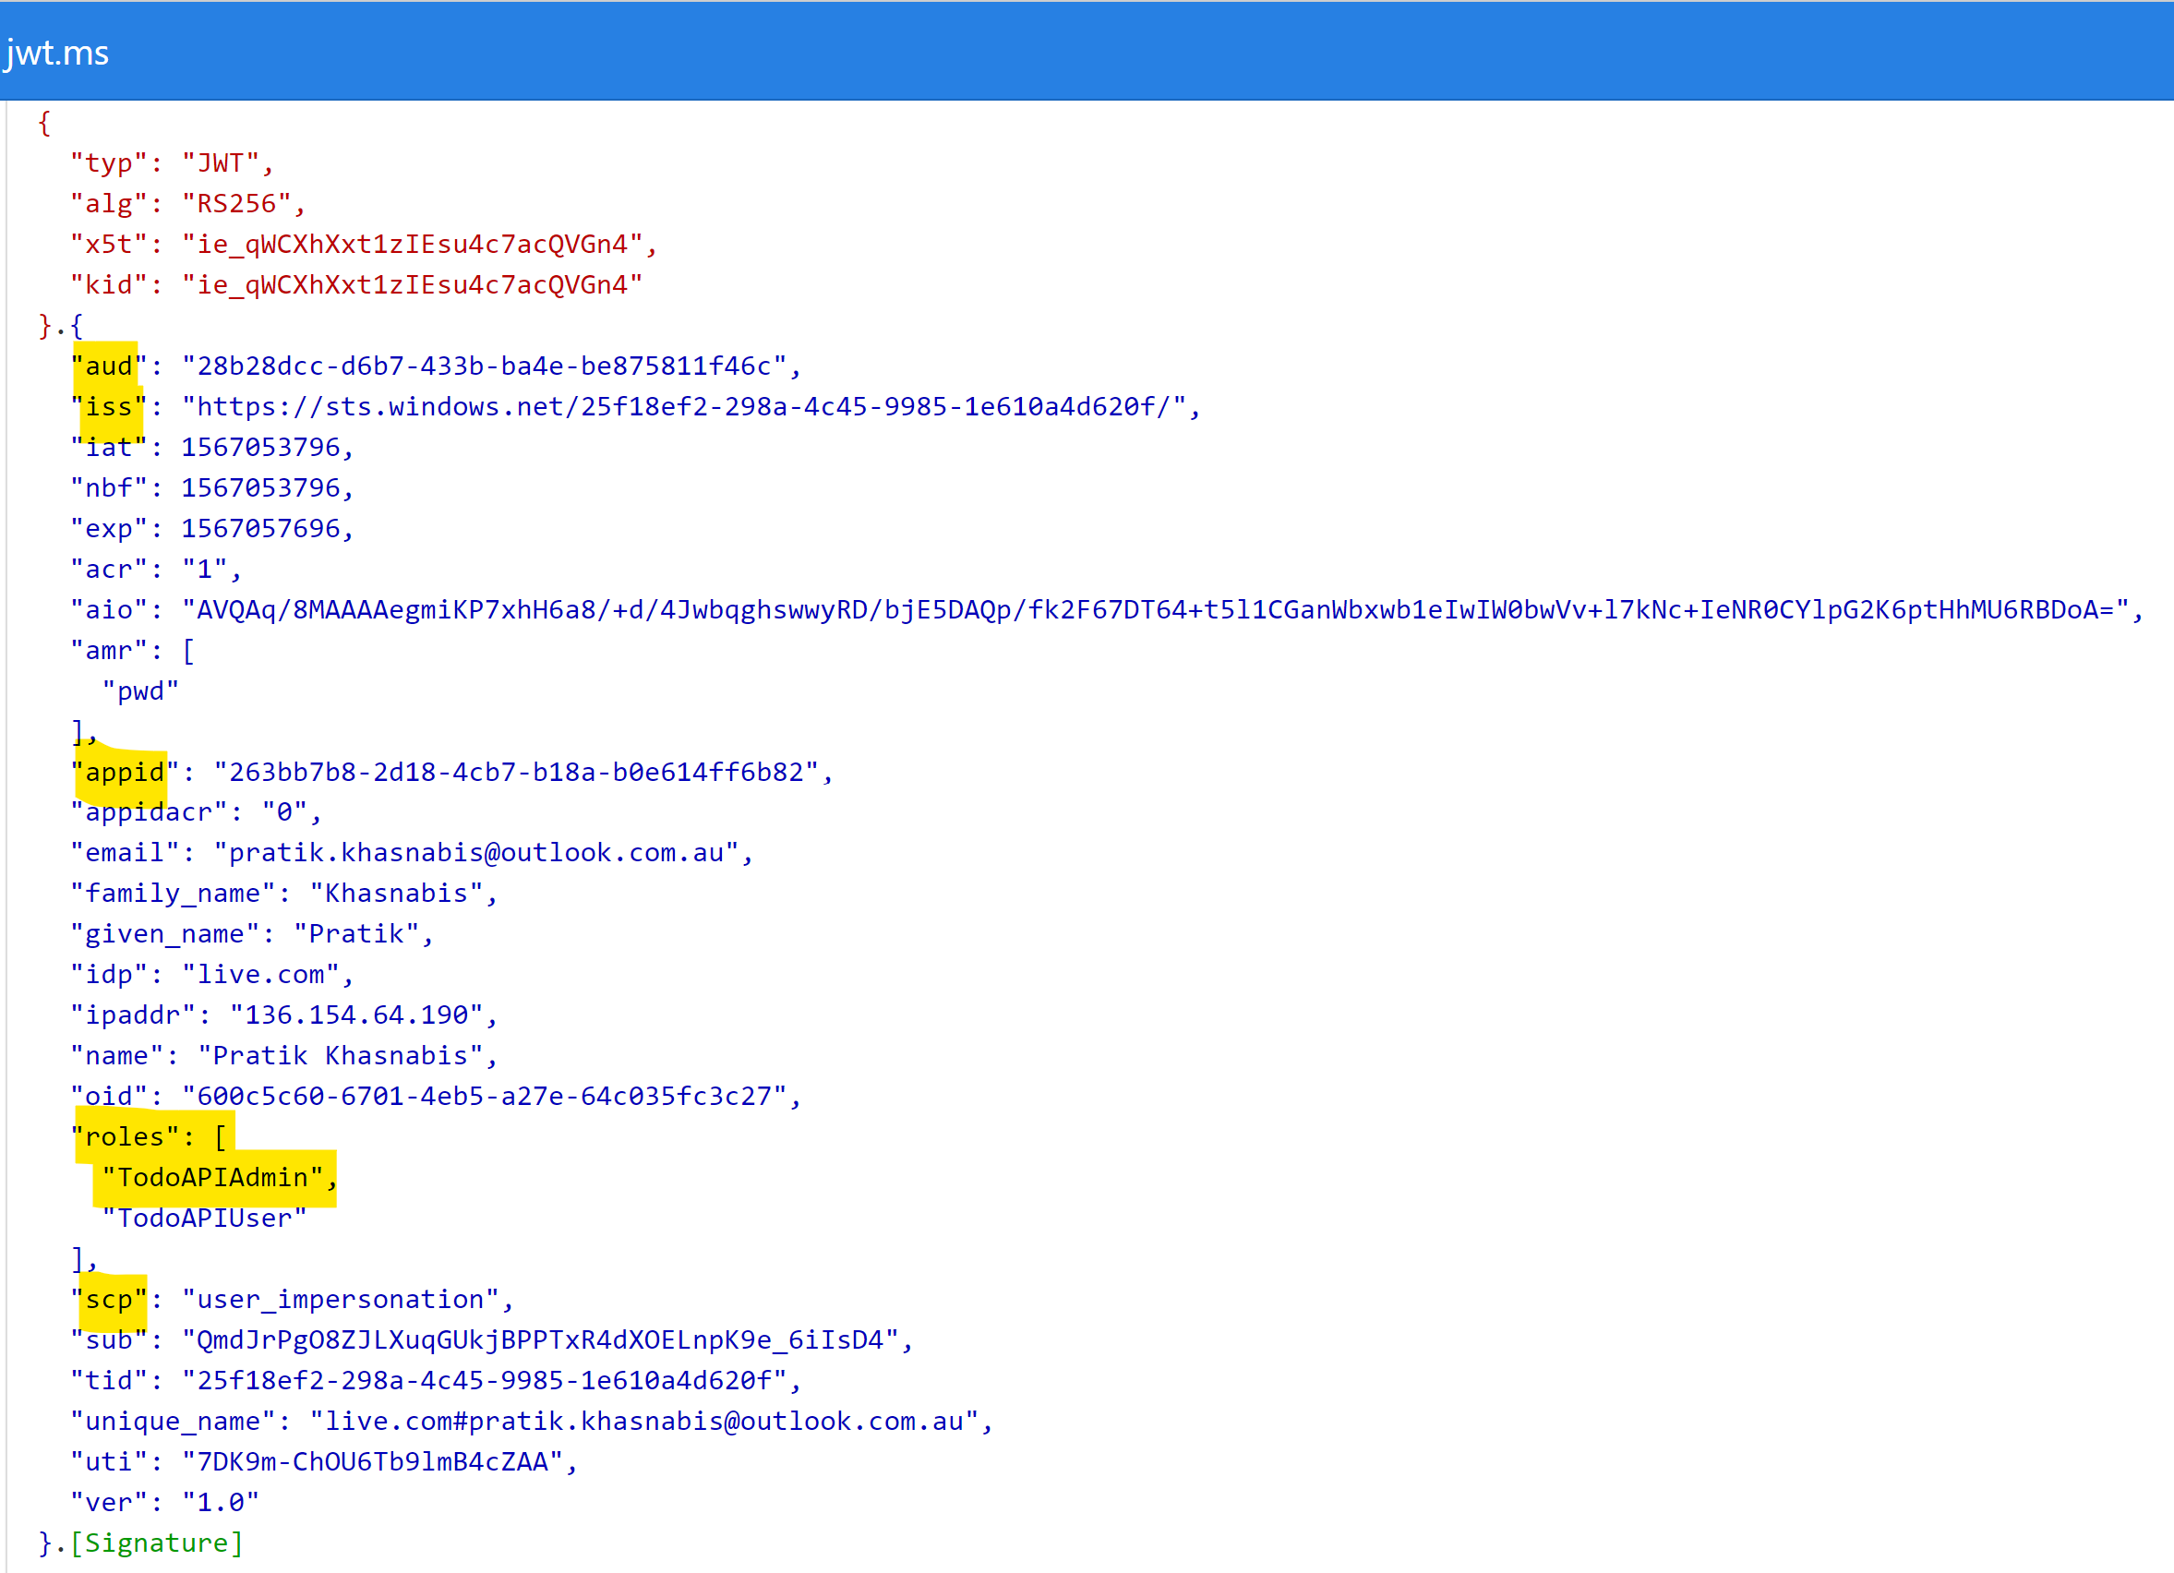
Inspect the JWT Access Token

Slide 31
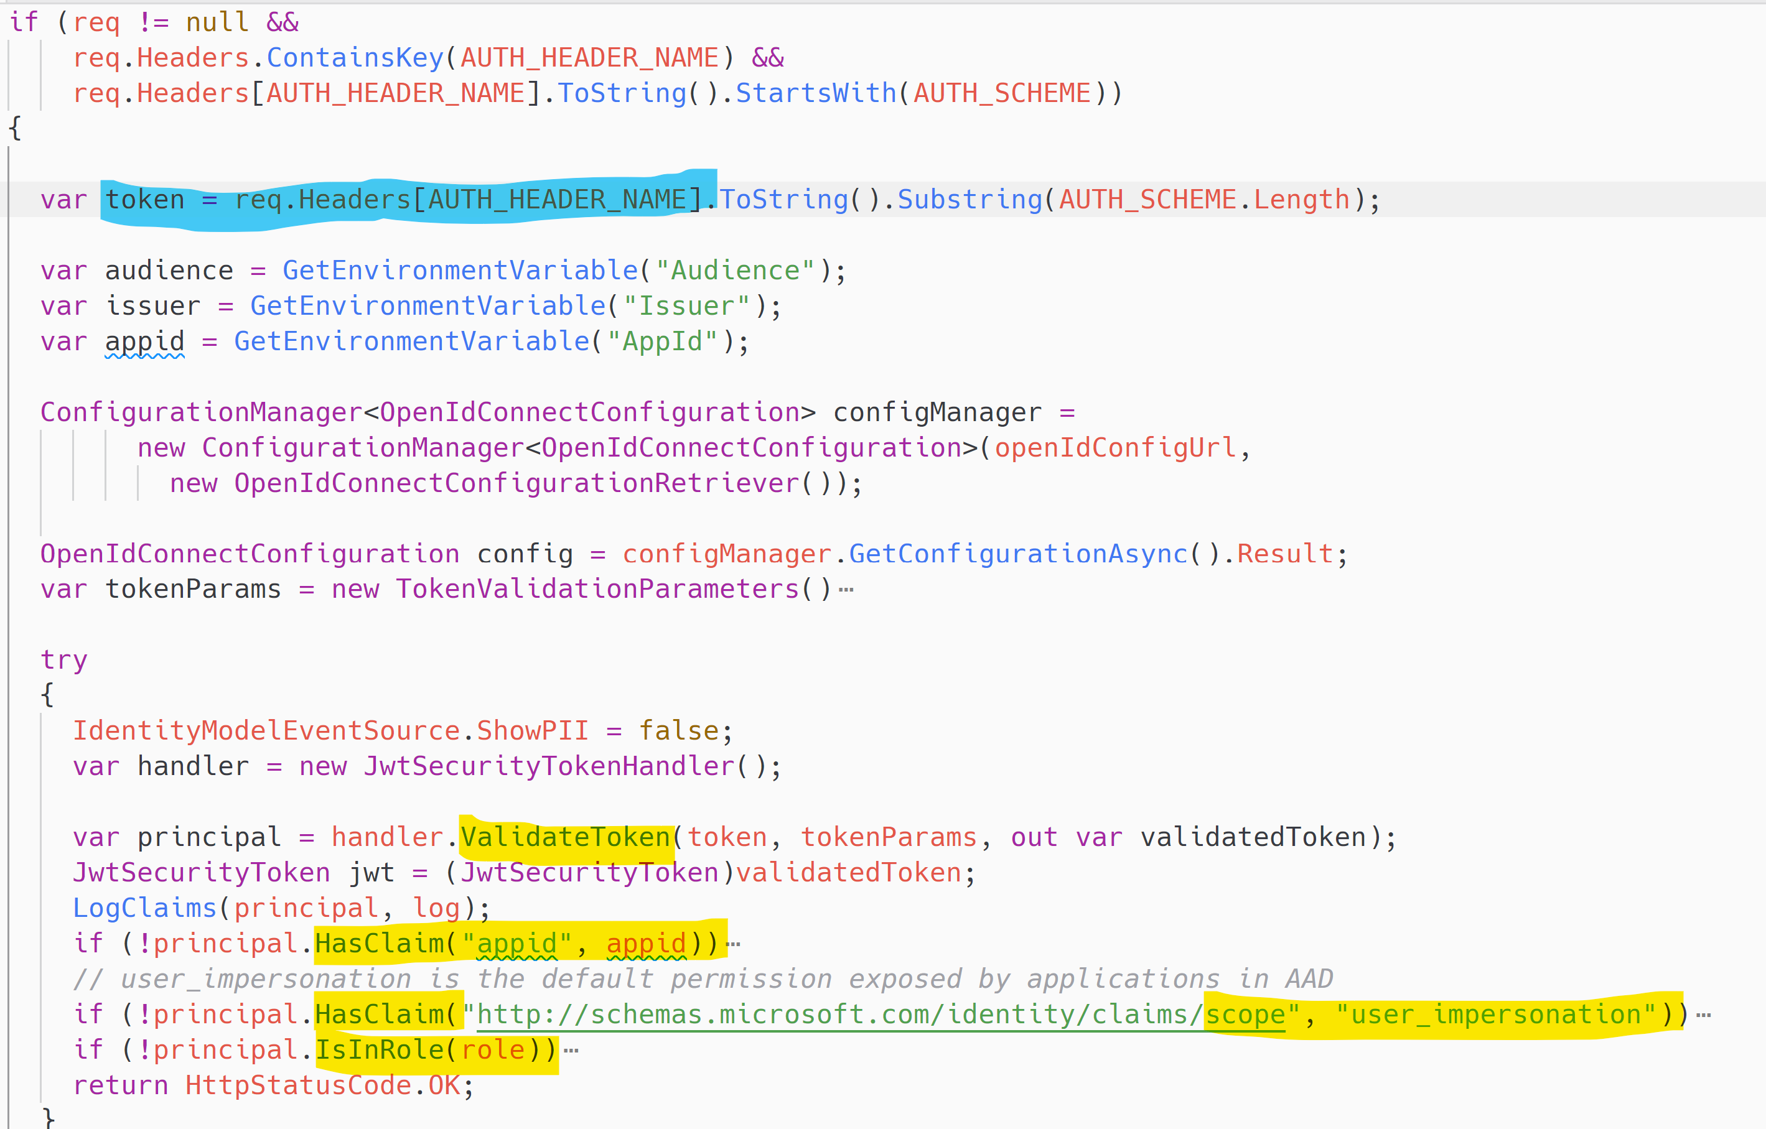
Token Validation & Role Check

Slide 32
Is This App Secure?

Slide 33
Credential Free Code
Managed Identity for Azure Resources (aka MSI)
MSI_ENDPOINT
MSI_SECRET
Notes:
https://docs.microsoft.com/en-us/azure/app-service/overview-managed-identity

Slide 34
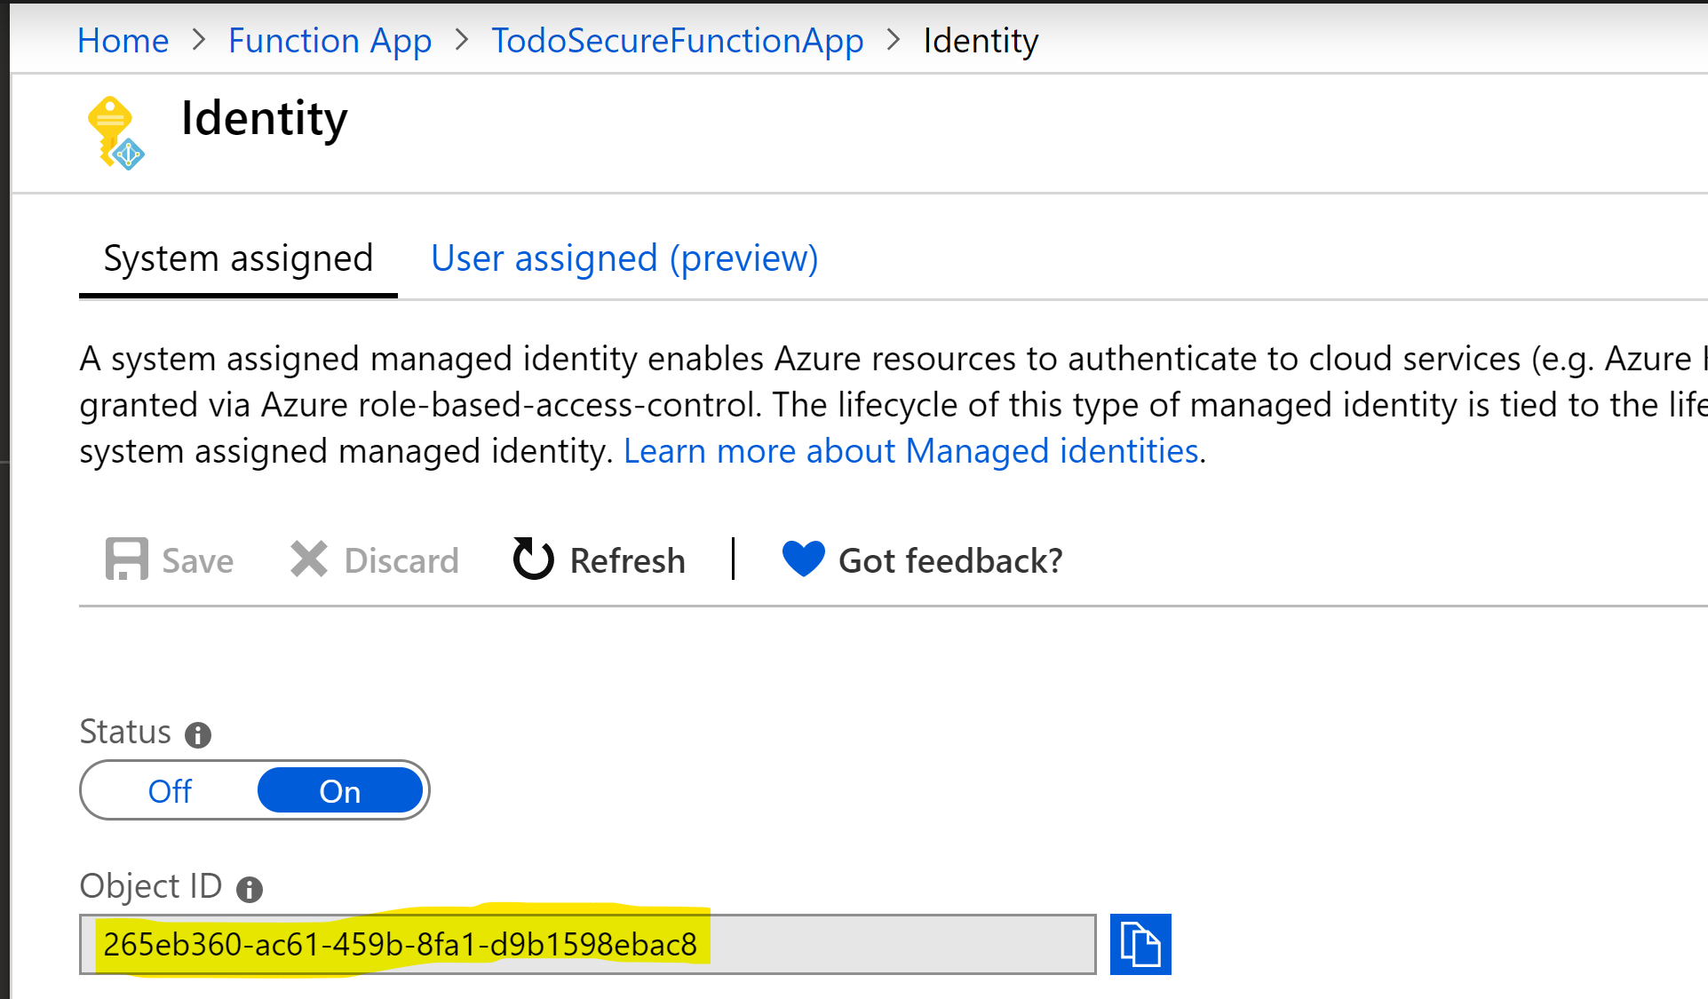
Create an Identity for the Function App

Slide 35
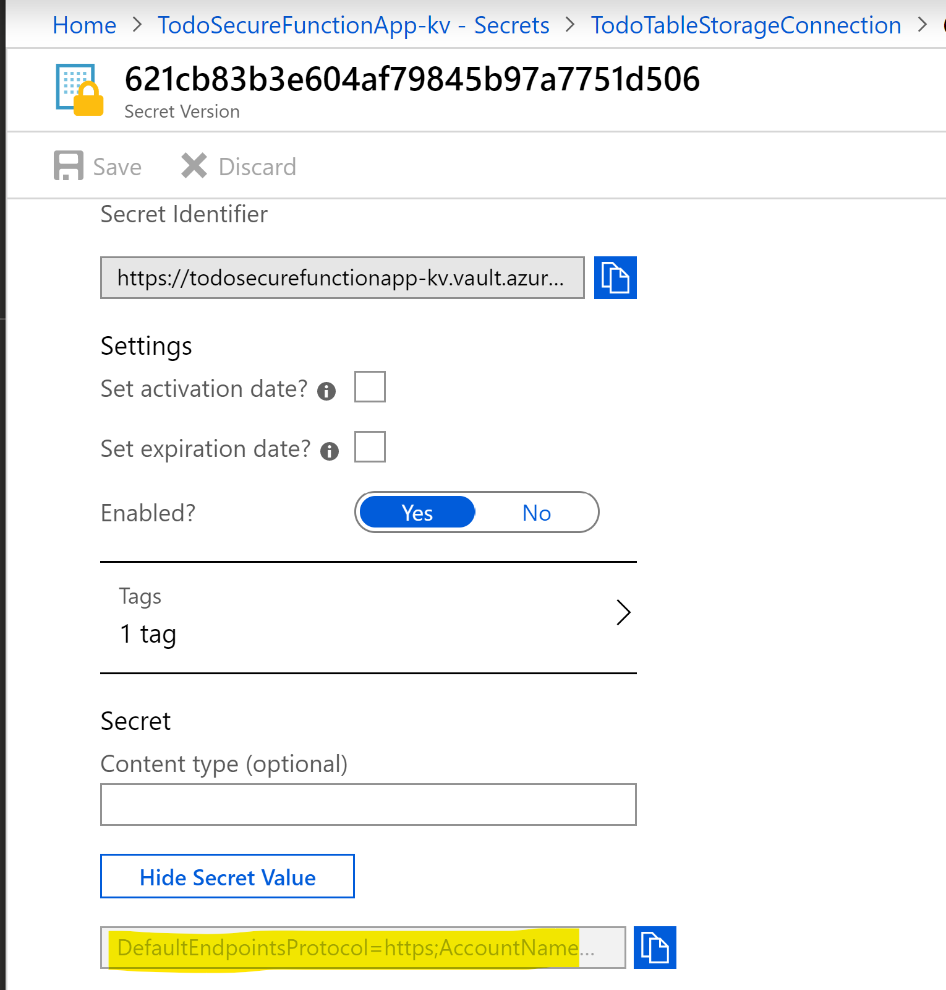
Save connection string as a secret in KV

Slide 36
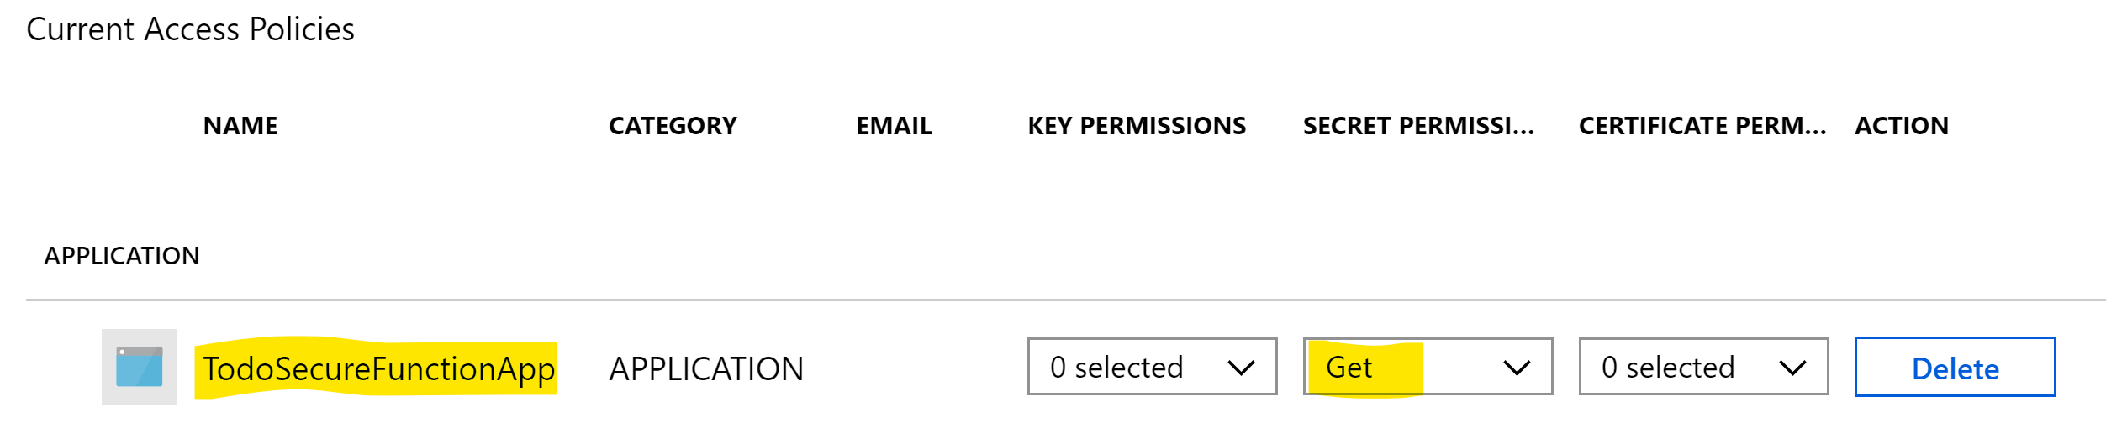
Set a Least Privilege Access Policy to the Function App Identity

Slide 37
Set the connection string value in Function App Application Settings
Format is @Microsoft.KeyVault(SecretUri=secret_uri_with_version)

Slide 38
Is this App Secure?

Slide 39
Secure Serverless Architecture
Notes:
https://github.com/mspnp/serverless-reference-implementation/blob/master/src/readme.md

Slide 40
Takeaways
Implement OAUTH 2.0 Implicit Flow in the SPA to get a access token for the Function App being called
Register the SPA and the Function App in Azure AD as applications
Change Function App application manifest and add “app roles”
Grant roles to users in AD for the Function App application
Publish the Function App in Azure API Management
Validate the JWT token in APIM policy
Check the role in the claims within the JWT in Function App code
Set Managed Identity for the Function App
Stote connection strings as secrets in Azure Key Vault
Grant least privilege access policy to the Function App MSI in the Key Vault
Change the application configuration for Function App to point to Key Vault

Slide 41
Thank you
Pratik Khasnabis
Azure Cloud Architect (MCSE & MCSD)
@softveda

Slide 42
Network security
Azure APIM
Azure App Gateway
Azure Frontdoor
Service Endpoints
Premium Hosting Plan
App Service Hosting Plan
App Service Isolated Hosting Plan

